Slide 1
UFT Hybrid Driven Automation Framework

Slide 2
Agenda
UFT Hybrid driven Automation Framework - Introduction, Highlights and Benefits
Framework Architecture
Case Study- Project Automation Approach
Framework Folders
Q & A

Slide 3
UFT Hybrid Driven Automation Framework - Introduction, Highlights and Benefits
Hybrid Automation Framework is a generic automation framework. It can be used for test automation.
It is a customized framework. This framework includes Data driven and keyword driven frameworks for software development.
This Framework is extensible and can be integrated with any other tool to create powerful and flexible automation solutions.
Eg : HP ALM, GIT, Jenkins
Customizable
Works for both windows and web apps
Supports multiple technologies – Java, Oracle, SAP, Mainframe, etc
Uses a low-code approach and is easy to learn
Provides easy-to read result reports and logs in HTML format.
Benefits
Easy to read and understand even by non-technical people(Product owner can involve to define acceptance criteria)
Highlights
Easy to use
Flagging of test cases that come handy before each run
Supports BPT approach
Detailed reports and logs of the execution status which is very helpful in case of failure of the script

Slide 4
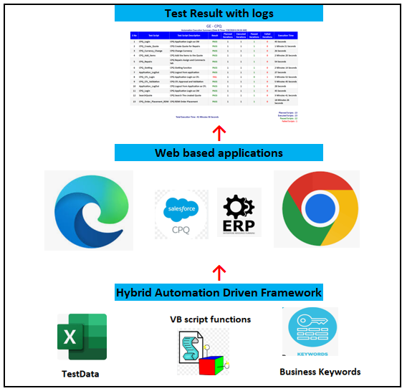
Hybrid Driven Automation Framework : High level Architecture
The test-data is supplied in simple, easy-to-edit excel format. When Hybrid automation Driven Framework is started, it processes the data, keywords and their related functions from functional library and executes test cases and generates logs and reports.
The core framework does not know anything about the target under test, and the interaction with it is handled by libraries.

Slide 5


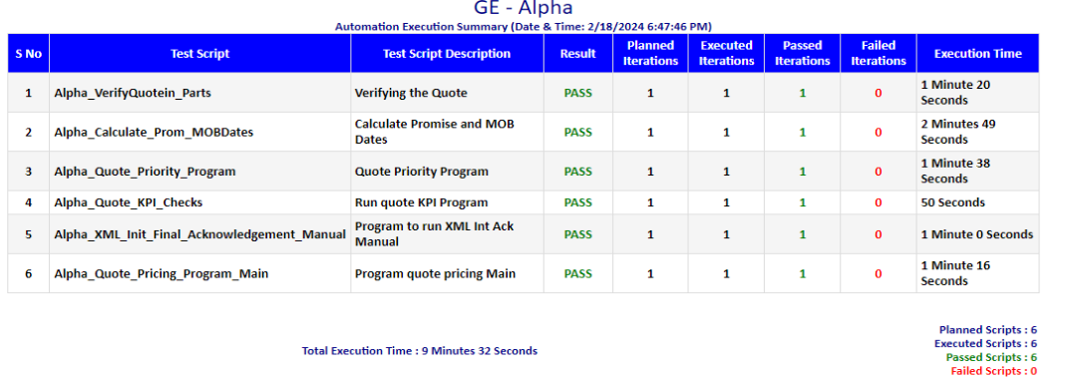




Case Study- Project Automation Approach : CPQ Application
Test Script Designing
Test Execution
HTML Results
Repository
Function Libraries
Test Scripts
Driver
Test Data
HTML Results
Integrated Applications
SAP
Alpha
PMx
ICS
PCE

Slide 6
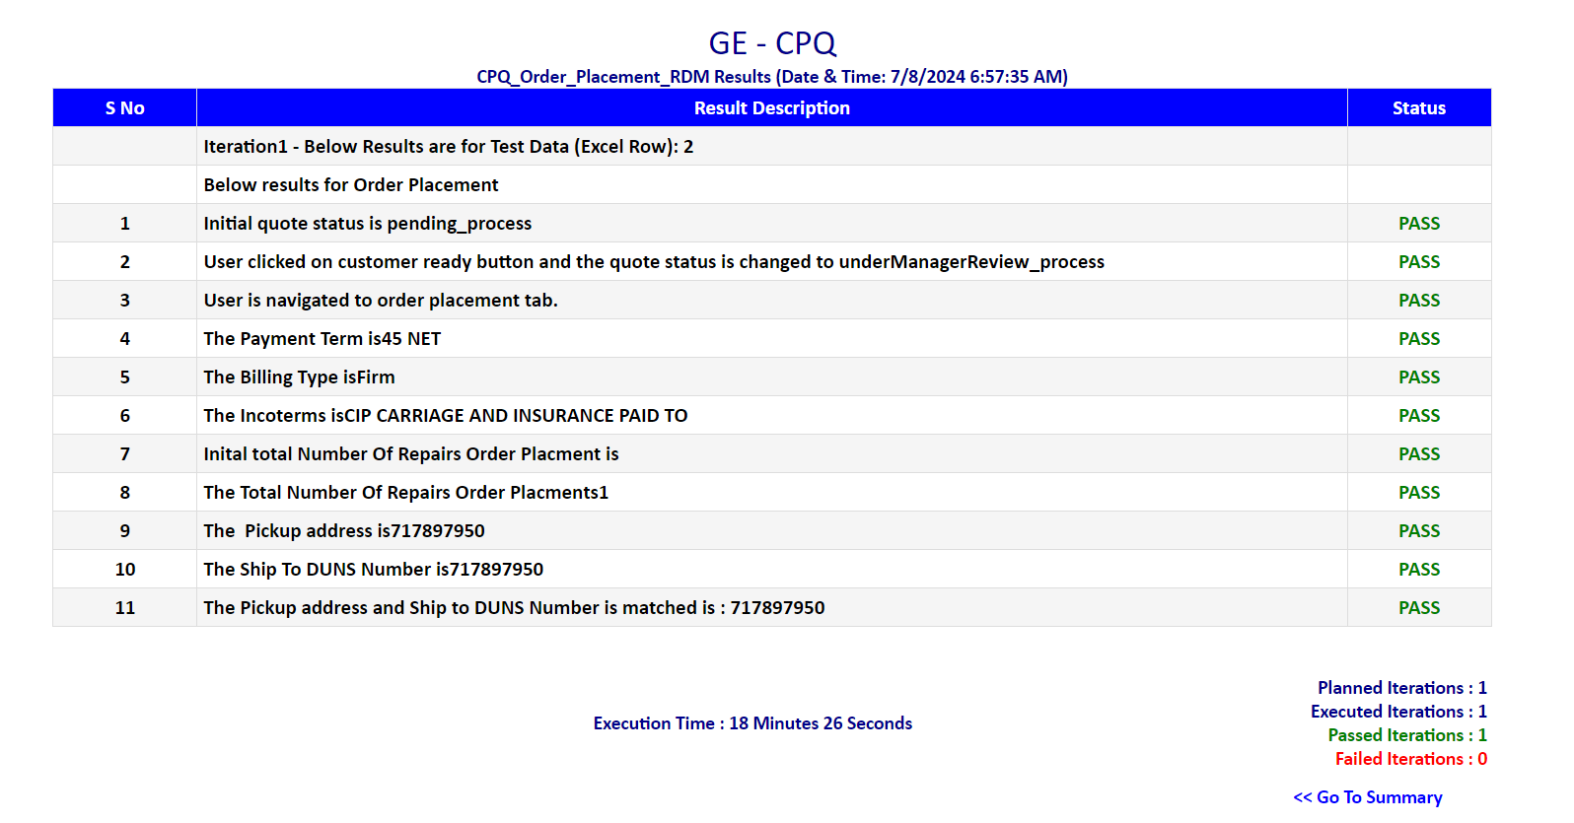
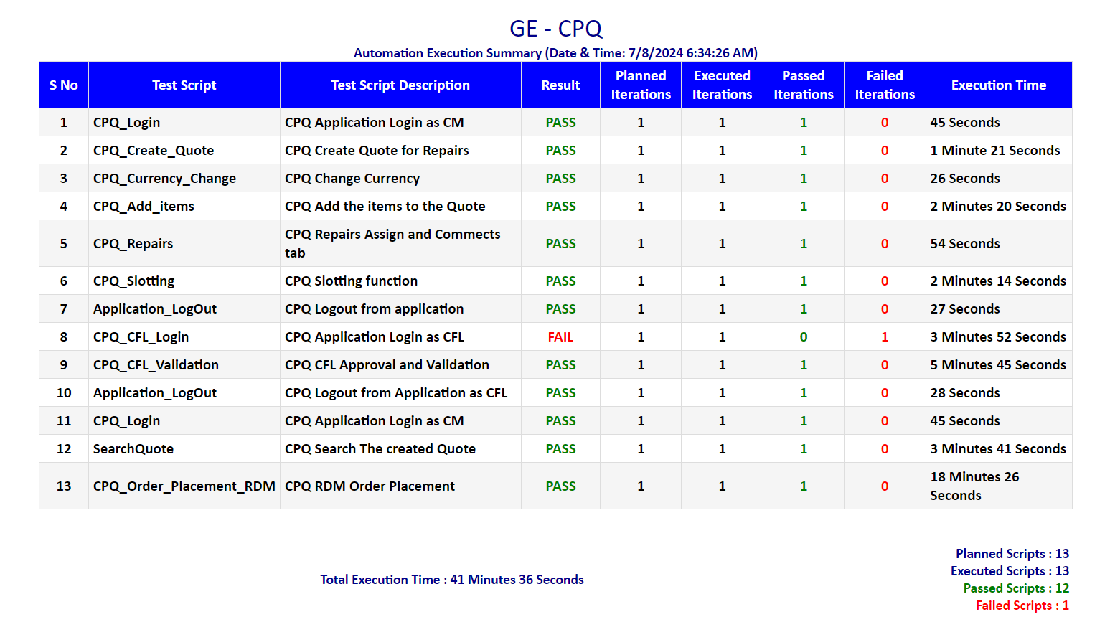
Test Execution Report
It provides detailed reports and logs of the execution status in html files which is very helpful in case of failure of the script.

Slide 7
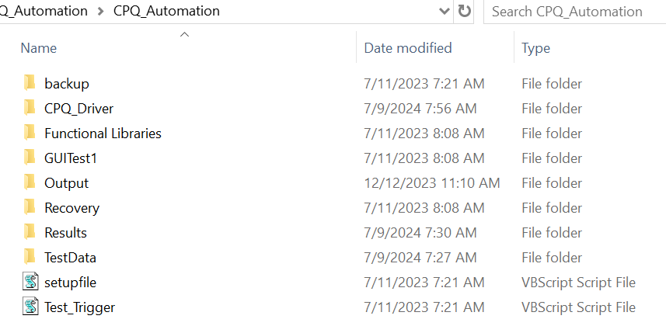
Project Architecture

Slide 8
Framework Folders
Driver
Function Libraries
Test Data
Test Results
Post execution html results will get saved in this folder.
Contains a driver script to drive the entire execution. I t reads the execution flag from data excel and depends on the flag the testcase will get called one after the another. This script is responsible for loading the respective application libraries at the run time.
This is the folder where all our framework related and application related reusable functions are written in .vbs / .qfl format .
This folder contains test data excel files.

Slide 9
Q & A

